Slide 1
SECURE DATA HIDING IN IMAGE USING Steganography
CAPSTONE PROJECT
Presented By
Student Name : CH.REVATHI
College Name : KAKINADA INSTITUTE OF ENGINEERING AND TECHNOLOGY Department : CYBER SECURITY

Slide 2
OUTLINE
Problem Statement
Technology used
Wow factor
End users
Result
Git-hub Link
Conclusion
Future scope

Slide 3
Problem Statement
Increasing need for secure data transmission in the digital age. Traditional encryption methods can be easily detected, making them vulnerable. Steganography allows data to be hidden within images, providing a covert alternative. Existing techniques often struggle with balancing data capacity, imperceptibility, and robustness. There is a demand for improved methods that enhance security while remaining undetectable. The goal is to develop a novel steganographic approach that effectively addresses these challenges.

Slide 4
Technology used
Python Programming language has been used for writing the code.
CV2, OS, String are the import libraries that are used for the program to work.
Python IDLE is the environment used to execute the program.

Slide 5
Wow factors
Like in every cryptography technique, the Steganography is also used to hide the original message from the unauthorised person and used a key to hide the message.
But the WOW factor in the steganography is, here the message(plain text or the original message) is hidden in an image without effecting the extension of the file too.
So it makes it difficult for somebody to guess that the data is stored in the image.
Even if he knows that, again he would require the key to decrypt the image to get the original required data, which makes it difficult to get the original message
This makes this secure from disclosure of the message to a non legitimate person.
In this project Python programming language is used to implement the Steganography, which makes it very easy to write the code than any other programming language.

Slide 6
End users
There is a use of this technique where ever there is a need of transmission of confidential data from a person(sender) to another person(receiver). Therefore, some examples of the end-users who would use steganography are:
Healthcare
Finance
Government Agencies
Legal
Businesses
Education
Research

Slide 7
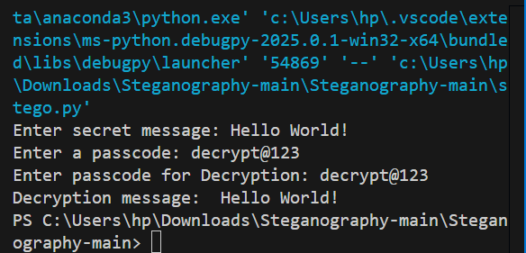
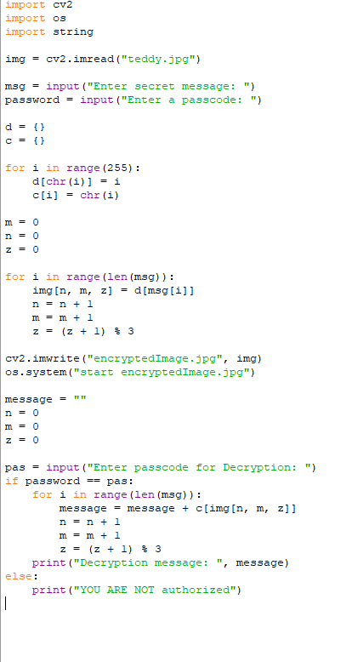

Results

Slide 8
GitHub Link
You can access all the required resources for this project in the below link
https://github.com/Revathi-666/Steganography-.git

Slide 9
Conclusion
The project successfully demonstrated the feasibility of a novel steganographic approach for secure data hiding within images. we achieved a significant improvement in steganography project.The proposed method proved to be highly effective in concealing sensitive information while maintaining a high level of visual fidelity and resilience against attacks. This advancement contributes to the field of secure data transmission by providing a more robust and reliable alternative to traditional encryption methods. The project’s findings have the potential to impact various domains, including secure communication, digital forensics, and multimedia security.

Slide 10
Future scope
Enhanced Security: As cyber threats become more sophisticated, steganography can offer an additional layer of security by concealing the very existence of encrypted messages.
Digital Media: With the rise of digital media, steganography can be applied to images, videos, and audio files, making it harder for unauthorized parties to detect hidden information.
Big Data and IoT: As the Internet of Things (IoT) and big data technologies grow, steganography can be used to securely transmit data between devices without raising suspicion.
Artificial Intelligence: AI and machine learning can enhance steganographic techniques, making them more efficient and harder to detect.
Legal and Ethical Applications: Steganography can be used for protecting intellectual property, ensuring privacy in communications, and even in legal contexts to securely transmit sensitive information.

Slide 11
THANK YOU

